Slide 1


Astrosage Call Analysis
Gulam Sarwar
09/08/2026

Slide 2
Introduction to AstroSage
AstroSage is a leading astrology platform offering horoscope matching, birth chart generation, and AI astrologers. It helps users with daily and specialized queries related to important life decisions. AstroSage provides astrological services through experts from different schools of astrology.
AstroSage handled 28,027 customer interactions in the analyzed period creating a significant opportunity to improve service efficiency and customer experience.
Objectives: The objective of this project is to analyze call and chat volumes, identify peak days and hours, evaluate call and chat completion, analyze agent workload and performance, measure customer satisfaction, identify operational and technology gaps, and recommend an effective allocation of the ₹1 Crore investment.

Slide 3
Astrosage Data Overview
28,027 records and 30 attributes covering customer calls, chats, Gurus, ratings, revenue and interaction status.
The dataset contains information on customer interactions, channels, call/chat status, agent performance, revenue and customer ratings.
The data was prepared in the Cleaned data worksheet for analysis.
Objective and Subjective worksheets were used to understand the business questions and analysis requirements.
The data is critical for identifying demand patterns, operational gaps, customer satisfaction issues and investment opportunities.
Standardized dates, times, categorical fields and numerical values, and created derived fields such as date, month and hour to ensure the dataset was accurate and analysis-ready.

Slide 4
Analytical Approach and Tools
Data Cleaning: Standardized date, time, categorical and numerical fields and prepared the dataset for analysis using Remove Duplicates, TRIM, PROPER, IF/ISBLANK and Paste as Values.
Data Enrichment: Created additional fields such as Date, Month and Hour to enable detailed time-based analysis.
Trend Analysis: Analyzed daily, monthly and hourly interaction patterns to identify demand and peak periods.
Data Analysis: PivotTables, grouping, sorting, filtering and formulas such as COUNT, COUNTIF, AVERAGE, ROUND, MAX, MIN, XLOOKUP, CORREL and GETPIVOTDATA
Visualization: Created Pivot tables and Charts, KPI cards and interactive slicers to present insights and enable data exploration.
Performance Analysis: Compared channel performance, completion rates, agent workload and customer ratings.
Business Insights: Demand trends, service completion, agent workload, customer satisfaction and revenue analysis

Slide 5
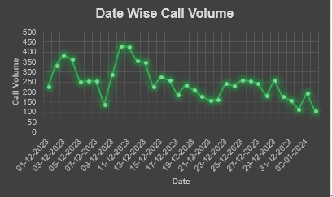
Customer Demand & Call Volume
Insights And Key Findings:
The average daily call volume was 245.97 calls.
December recorded the highest call volume with 8,090 calls.
January recorded the lowest call volume with 418 calls.
The sharp variation in demand indicates the need for flexible, demand-based workforce planning.
December also resulted in significantly higher operational cost due to the higher workload.
Key takeaway:
Call demand varies significantly over time, making flexible staffing more effective than maintaining fixed staffing levels.

Slide 6
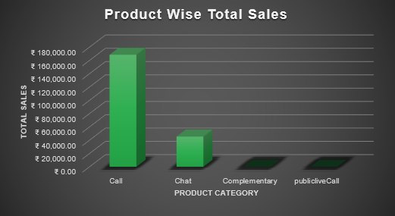
Revenue & Interaction Performance
Insights And Key Findings:
Call is the largest revenue-generating consultation type.
Calls generated approximately ₹1.69 lakh, substantially more than chat.
The analysis recorded 8,365 calls in the User ID/Guru ID analysis.
This shows the call channel strategically important for revenue protection and improvement.
Key takeaway:
Calls contribute the majority of revenue, making call-service reliability and performance a key business priority.

Slide 7
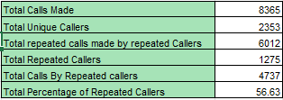
Agent Performance & Customer Satisfaction
Insights And Key Findings:
Average calls handled per agent per day: 1.88.
1,275 repeat callers were identified, representing 35.19% in the submitted analysis.
Call duration and customer satisfaction show almost no correlation (0.0548).
Highest Guru satisfaction score: 7.5.
Lowest Guru satisfaction score: 0.
December's average rating (2.94) was higher than January (2.67).
Key takeaway:
Customer satisfaction cannot be improved simply by increasing call duration; service quality, successful resolution and customer experience are more important areas to address.

Slide 8
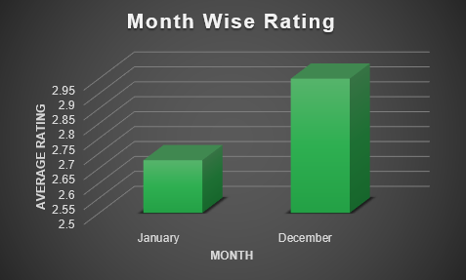
Investment Priority
Insights And Key Findings:
Low average customer satisfaction (2.93) indicates a significant service-quality issue.
High failed and incomplete interactions indicate process inefficiency.
Short average call duration suggests an opportunity to improve customer engagement.
Technology upgrades should receive the largest investment because they can address systemic service issues at scale.
Training should improve communication, customer handling and technology adoption.
Hiring should be targeted to peak-demand periods, rather than broad hiring.

Slide 9
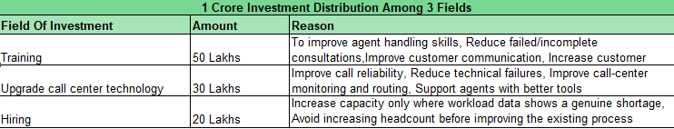
Area Of Investment:
Training: ₹50 lakh (50%)
Technology: ₹30 lakh (30%)
Hiring: ₹20 lakh (20%)
Key takeaway:
The data suggests that the main challenge is not simply a shortage of agents. Low customer satisfaction and service-quality gaps indicate that improving agent skills and customer handling should be the highest priority, supported by targeted technology upgrades and hiring where workload data shows a genuine need.

Slide 10
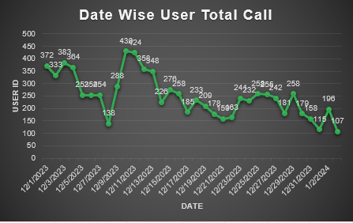
Investment Risks & Mitigation Strategy
Insights And Key Findings:
Technology: Implement upgrades gradually instead of changing the entire system at once.
Training: Measure whether training improves customer handling and service quality.
Hiring: Use workload and demand data to determine where additional agents are actually needed.
The project recommends phased technology implementation, including IVR, AI-based routing, chatbots and speech analytics, with pilot testing before full deployment.
Key takeaway:
Each investment option carries a different risk, so the solution is to invest gradually, measure results and scale only what works.

Slide 11
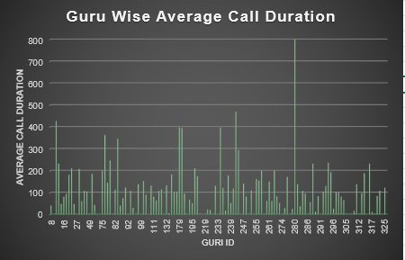
Investment | Main Risk | Mitigation
Technology | High cost/ implementation failure | Pilot testing + phased rollout
Training | Training may not translate into performance | Measure ratings, completion and agent KPIs
Hiring | Higher fixed costs without solving service problems | Hire only where workload data supports it

Slide 12
From Operational Gaps to a Technology Roadmap
Insights And Key Findings:
Phase 1: Improve Core Operations
Routing + IVR + Workforce Management
This reduces failed calls and match staffing with demand.
Phase 2: Reduce Repetitive Work
CRM + Chatbots + Agent Assist
This reduce repetitive workload and give agents better customer context.
Phase 3: Improve Quality & Decision-Making
Sentiment Analysis + Quality Assurance + Real-Time Business Intelligence
This helps in improving coaching, service quality and investment decisions.
Key takeaway:
The recommended approach is not a single technology upgrade. It is a phased transformation that first fixes service efficiency, then reduces repetitive workload, and finally improves quality monitoring and decision-making.

Slide 13
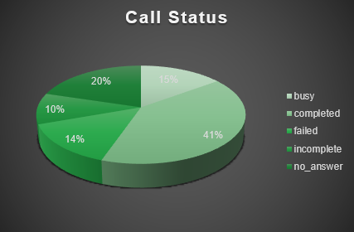
Strategic Recommendation 1: Improve Service Efficiency
Invest in technology to improve call and chat handling efficiency
Data-Driven Reason
Call and chat completion rates indicate significant room for improvement.
28,027 total interactions show a substantial customer-service workload.
Peak-hour demand creates pressure on available agents.
Technology such as smart call routing, IVR, chatbots and agent-assist tools can reduce waiting time and improve successful interactions.
Expected Impact
Higher call/chat completion rates.
Reduced waiting and failed interactions.
Improved customer experience.
Better use of agent capacity.

Slide 14
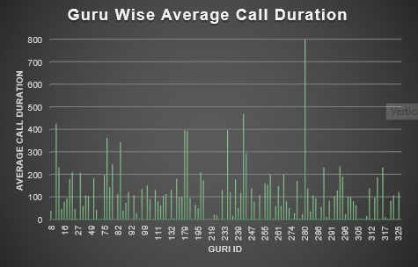
Strategic Recommendation 2: Improve Agent Performance
Implement targeted training and performance monitoring for Gurus
Data-Driven Reason
Customer satisfaction is relatively low, with an overall average rating of approximately 2.93.
Agent workload and performance vary across Gurus.
Rating and workload analysis can identify agents who need additional support or training.
Expected Impact
Higher customer satisfaction.
More consistent service quality.
Better agent productivity.
Improved customer retention.

Slide 15
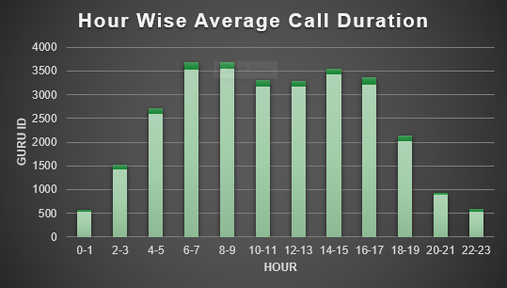
Strategic Recommendation 3: Implement Demand-Based Workforce Planning
Align Guru availability and staffing with customer demand patterns
Data-Driven Reason
Customer interactions vary significantly by day, month and hour.
08:00AM is the identified peak hour, indicating concentrated demand.
Fixed staffing throughout the day can lead to under-utilization during low-demand periods and pressure during peak periods.
Expected Impact
Reduced waiting time
Better coverage during peak periods
Improved agent utilization
Lower unnecessary operational costs
Better overall customer experience
Key takeaway:
Use data-driven workforce planning to put the right number of Gurus in the right place at the right time.

Slide 16
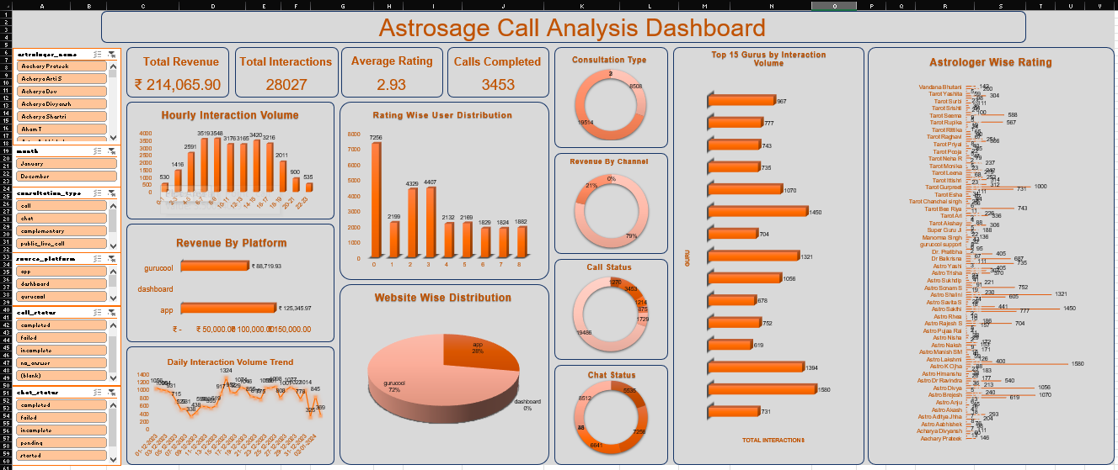
Astrosage Call Analysis Dashboard

Slide 17
Key Features Of The Dashboard
KPI Cards: Quickly monitor key business metrics such as total revenue, total interactions, completed calls and average rating.
Charts & Graphs: Visualize call/chat volume, revenue contribution, interaction status and customer satisfaction.
Slicers: Interactively filter the dashboard by Astrologer Name, Month, Consultation Type, Source Platform, Call Status, and Chat status.
Dynamic Analysis: Selecting a slicer automatically updates the connected PivotTables and charts.
The dashboard converts the detailed Excel analysis into an interactive view, helping decision-makers quickly identify demand patterns, service gaps, revenue trends and customer experience issues.

Slide 18
Conclusion
Insights And Key Findings:
The analysis of 28,027 customer interactions revealed important patterns in demand, service performance, agent workload and customer satisfaction.
Customer demand varies across days, months and hours, highlighting the need for demand-based workforce planning.
Calls are the major revenue-generating channel, making call-service efficiency an important business priority.
Customer satisfaction and service completion show opportunities for improving the overall customer experience.
The recommended ₹1 Crore investment should prioritize employee training, technology and targeted hiring.
A phased technology roadmap can improve service efficiency, reduce repetitive workload and strengthen quality monitoring.
Key takeaway:
By turning customer interaction data into actionable insights, AstroSage can improve service efficiency, strengthen customer satisfaction and make smarter investment decisions.

Slide 19
Acknowledgements & References
Acknowledgements:
Newton School: Project guidelines, learning resources and mentorship.
Project Mentor/Instructor: Guidance and feedback throughout the project.
References & Data Sources:
AstroSage Project Dataset: Cleaned Data Worksheet
Objective Questions: Objective Worksheet
Subjective Questions: Subjective Worksheet
Microsoft Excel: Data cleaning, PivotTables, Pivot Charts, formulas and dashboard creation.

Slide 20
Thank You
It Ends Here

